Slide 1
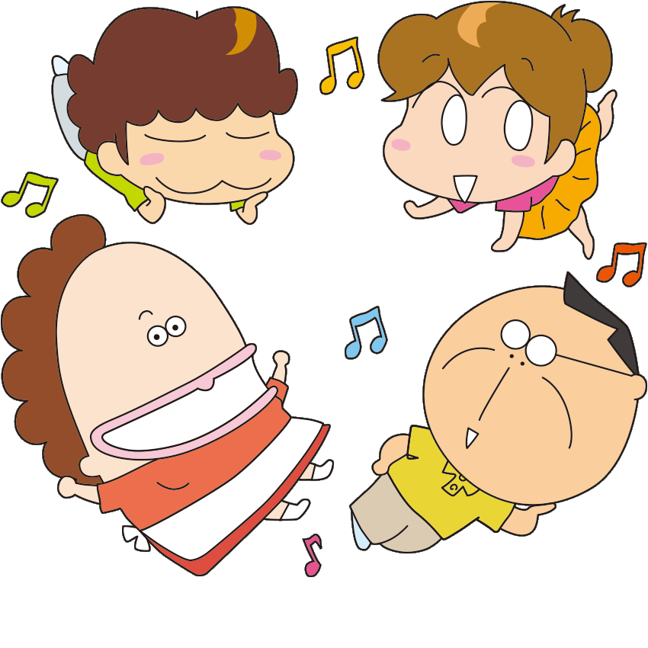
brother
sister
mother
father

Slide 2
father
dad、daddy

Slide 3
mother
mom、mommy

Slide 4
sister

Slide 5
grandpa
grandfather

Slide 6
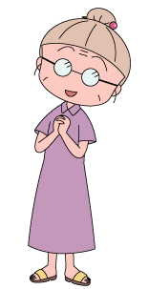
grandma
grandmother

Slide 7
mother
3
grandma
2
5
sister
father
grandpa
me
1
4

Slide 8
brother

Slide 9
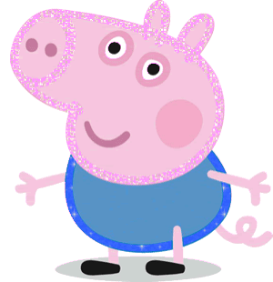
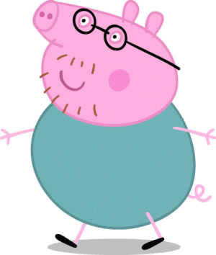
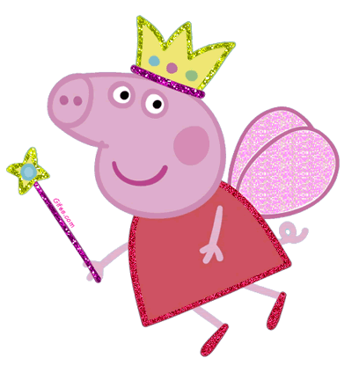
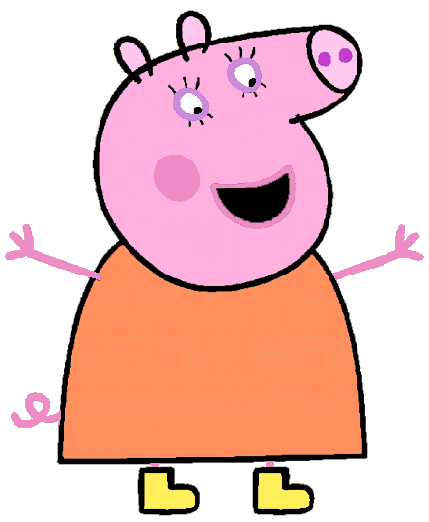
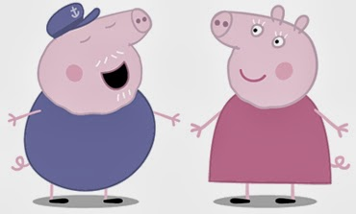
brother
3
1
grandpa
5
father
me
4
2
grandma
mother

Slide 10
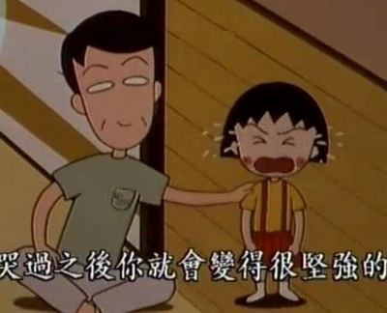
He’s my father.

Slide 11
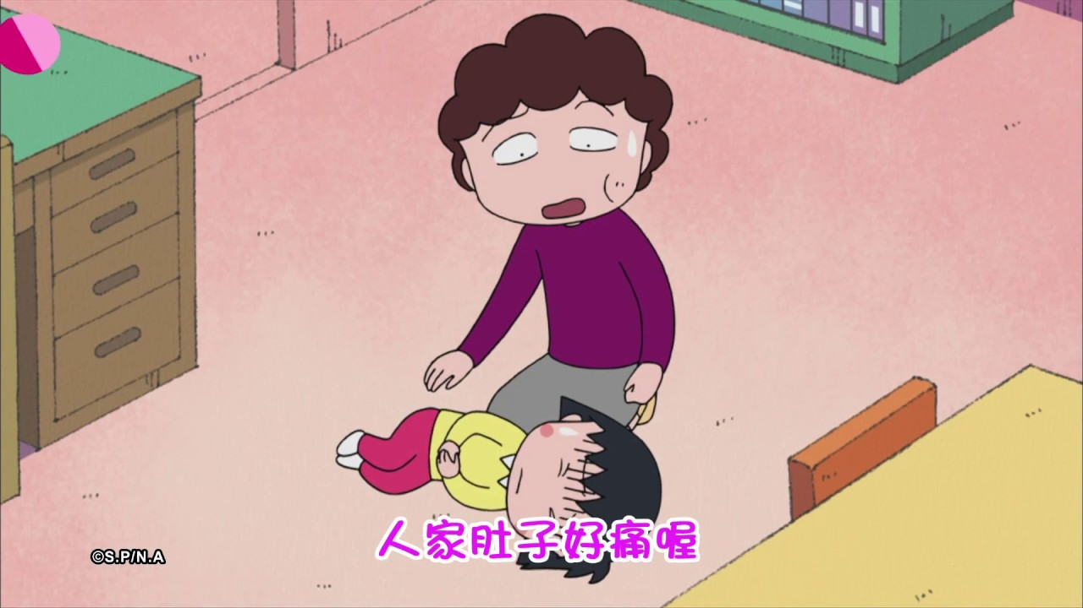
She’s my mother.

Slide 12
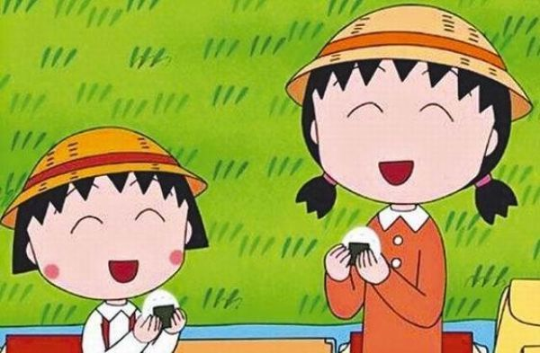
She’s my sister.

Slide 13
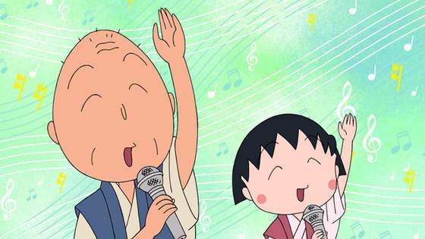
He’s my grandpa.

Slide 14
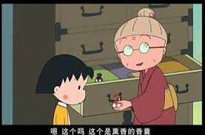
She’s my grandma.

Slide 15
He’s my brother.

Slide 16
He
She
He is = He’s
She is
= She’s

Slide 17
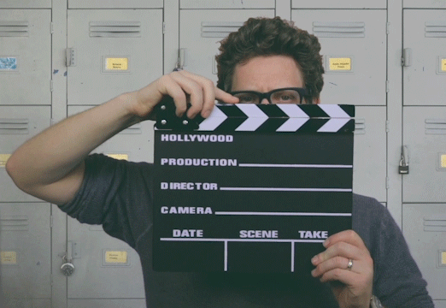

Slide 18
【本週英語作業】
1.聆聽和跟讀英語 CD。
2.完成讀寫練習本P17~P20。
3. 背第3課單字。

Slide 19
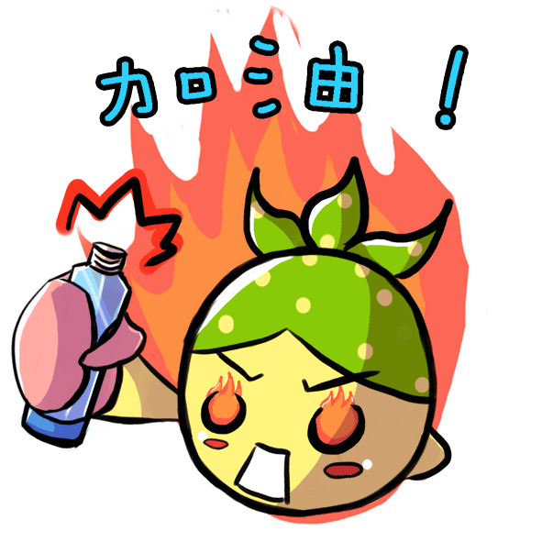
Challenge Time!!!

Slide 20
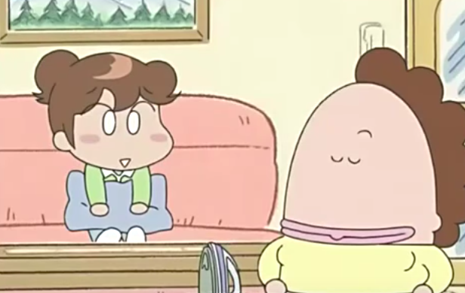
___ my _______.
She’s
mother

Slide 21
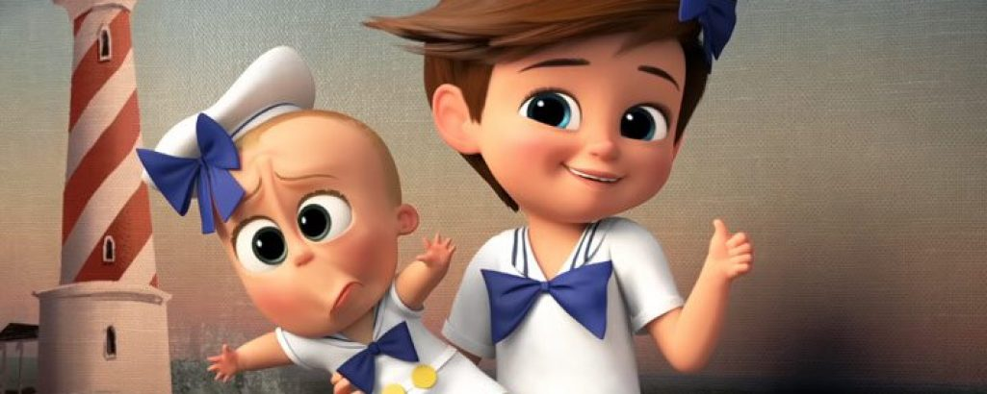
___ my _______.

Slide 22
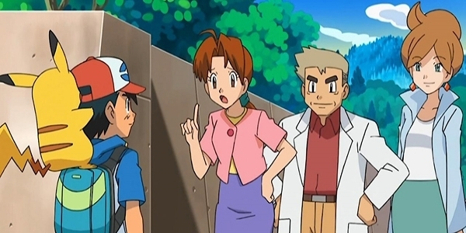
___ my _______.

Slide 23
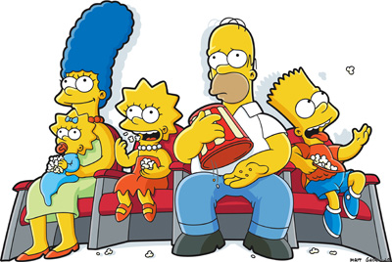
___ my _______.

Slide 24
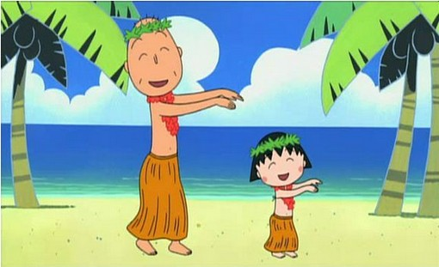
___ my _____.

Slide 25
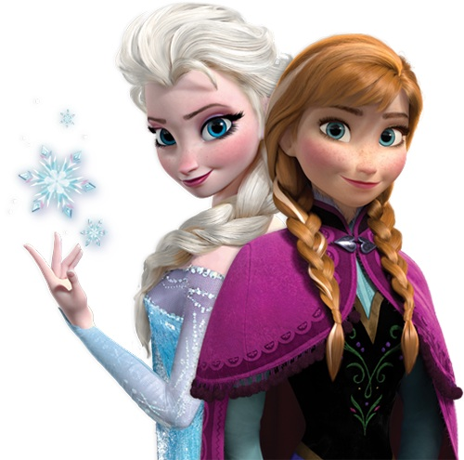
___ my _______.

Slide 26
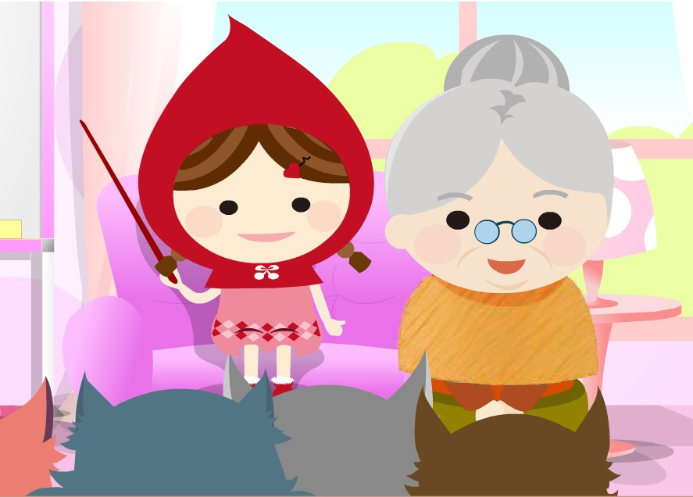
___ my _______.

Slide 27
___ my _____.

Slide 28
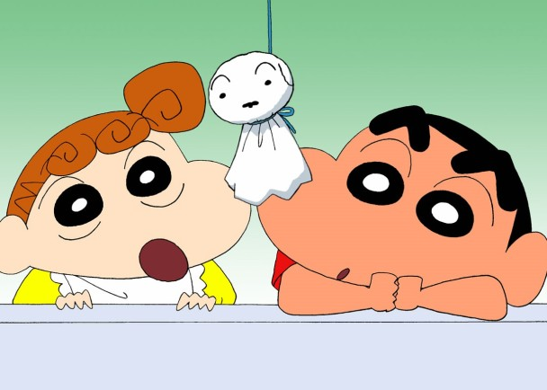
___ my ______.

Slide 29
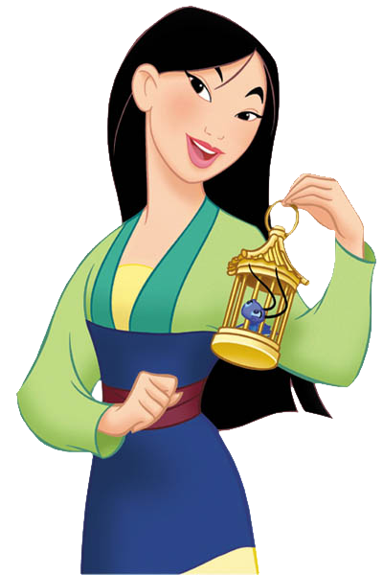
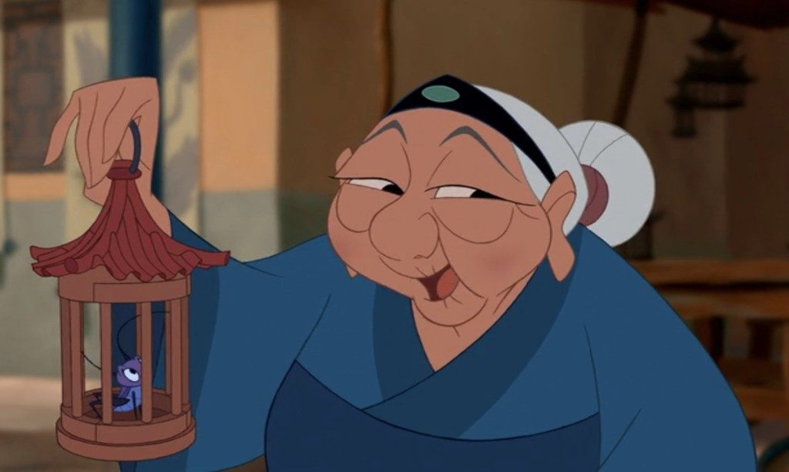
___ my _____.

Slide 30
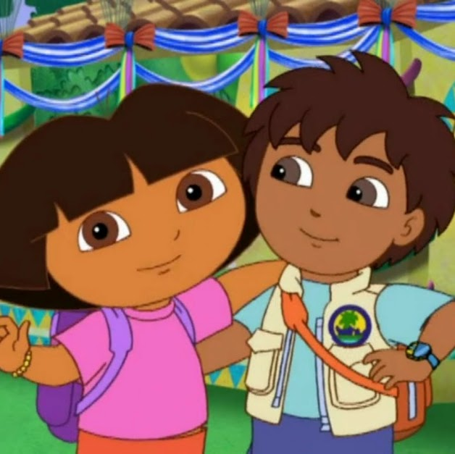
___ my _______.

